Slide 1

Tokyo Disney Resort Rail/Train Simulation
Braydon Spangler
pic credit: https://www.jtbthailand.com/th/tickets/tokyo-disney-resort-3/

Slide 2
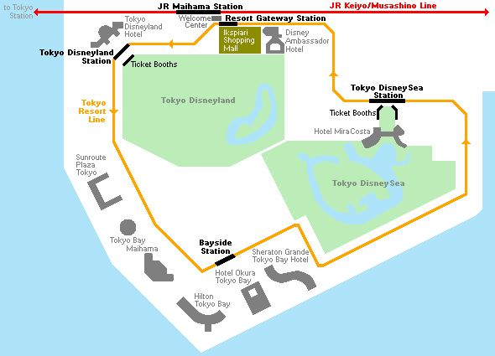
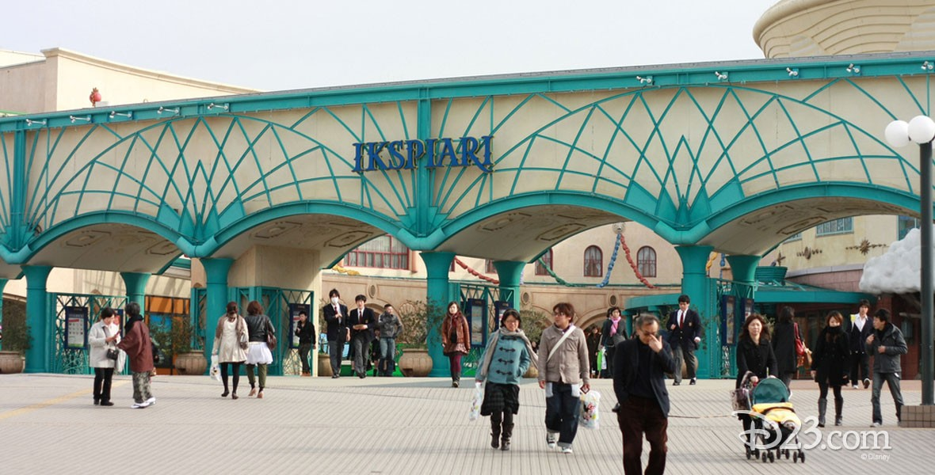
Goal
Create an accurate simulation of people moving from Maihama JR Station to one of the four stops of the Disney Resort Line
Both parks main access is via another train after exiting Maihama Station
Time adjustment slider to simulate rush hour at opening and closing times
pic credit: https://www.japan-guide.com/e/e3016_access.html
pic credit: https://d23.com/a-to-z/ikspiari/

Slide 3
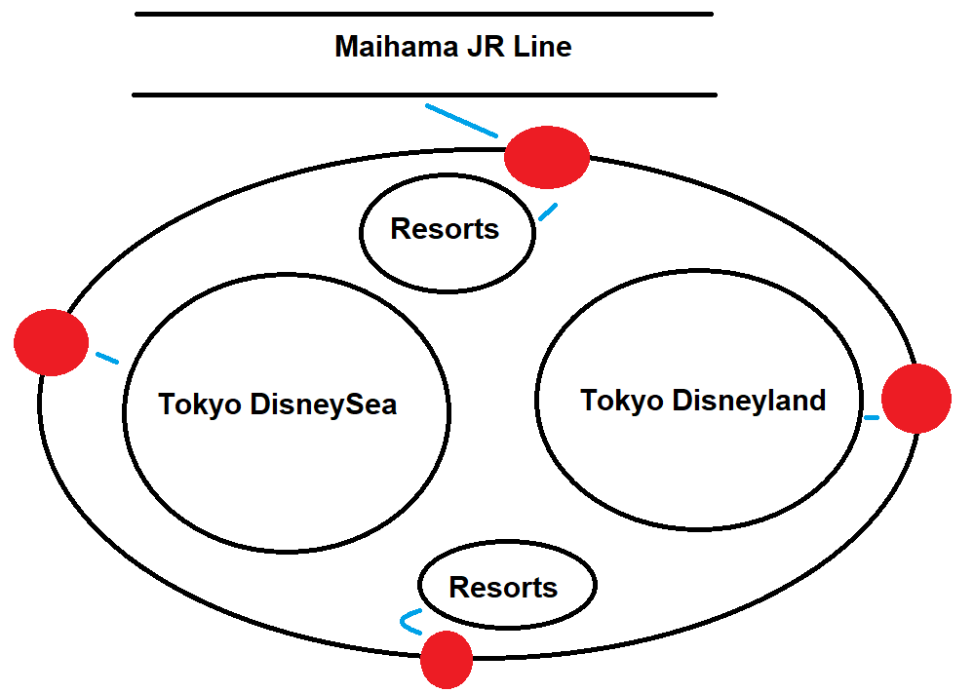
Statistics
A train arrives at Maihama JR Station every ~10min
Takes ~7min to walk from Maihama JR Station to Resort Gateway Station
A train arrives at Maihama JR Station every 6min
Morning rush at opening
and closing will boost rush
by ~5x, evening rush by 7x

